Slide 1
Federal Regulation on Cost Transparency
Starting January. 1, 2021, Price transparency rule requiring hospitals to publish descriptions and standard, discounted, and payer-negotiated rates for at least 300 common medical services (70 identified by CMS and 230 that can be selected by the hospital) to the public in a “consumer-friendly manner”.
By January 1, 2022, the rule requires that insurers and plans make public the following detailed price information in three separate “machine-readable files”, with monthly updates:
1) negotiated rates for all covered items and services between the plan and in-networks providers;
2) historical payments and billed charges from out-of-network providers;
3) in-network negotiated rates and historical net prices for all covered prescription drugs at the pharmacy location level.
By January 1, 2023, Insurers must make this pricing information and personalized cost-sharing estimates ( i.e. deductible payments, co-pays, and coinsurance) available to enrollees on an online consumer-usable tool for 500 “shoppable” services, and then for the remainder of all covered serviced and items by January 1, 2024.

Slide 2
Goals & Challenges
Key Goals & Challenges
Understand incentive for member to shop for lower-cost alternatives
How to steer member to high-value care
costs listed were in relation to the benefits plan and not true cost comparisons between facilities or providers
Others:
Quality metrics played a huge role in the member steerage.
Provide member with healthcare cost and quality information, help them to choose higher quality providers

Slide 3
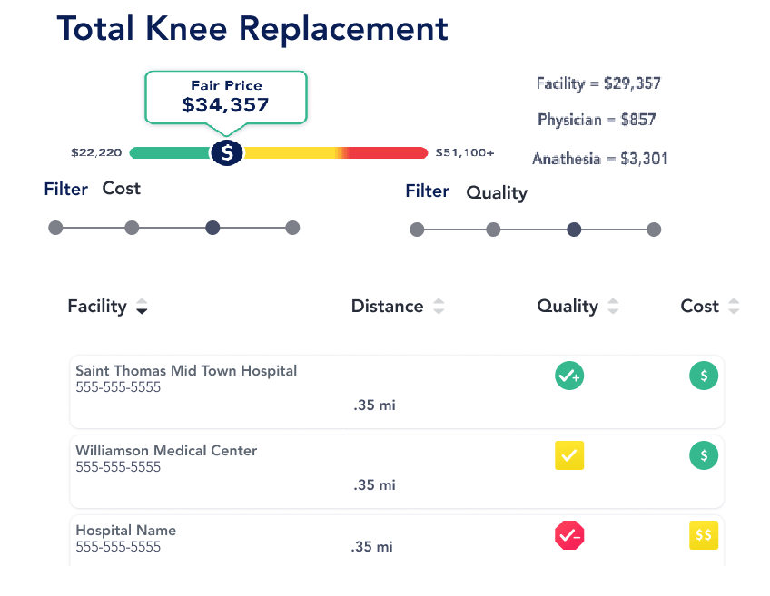
Mockup

Slide 4
Impact on Contract Negotiation
Negotiation benefit on the influential plans:
Rates disclosure could help use steering clauses with influential provider for negotiating lower reimbursement for guaranteed volumes through network tiering
Negotiation benefit for the less influential plan :
challenge the higher negotiated rate from larger health systems that have leveraged their scale to negotiate higher rates before;
smaller plans could use the data to improve their negotiating position and extract lower rates.

Slide 5
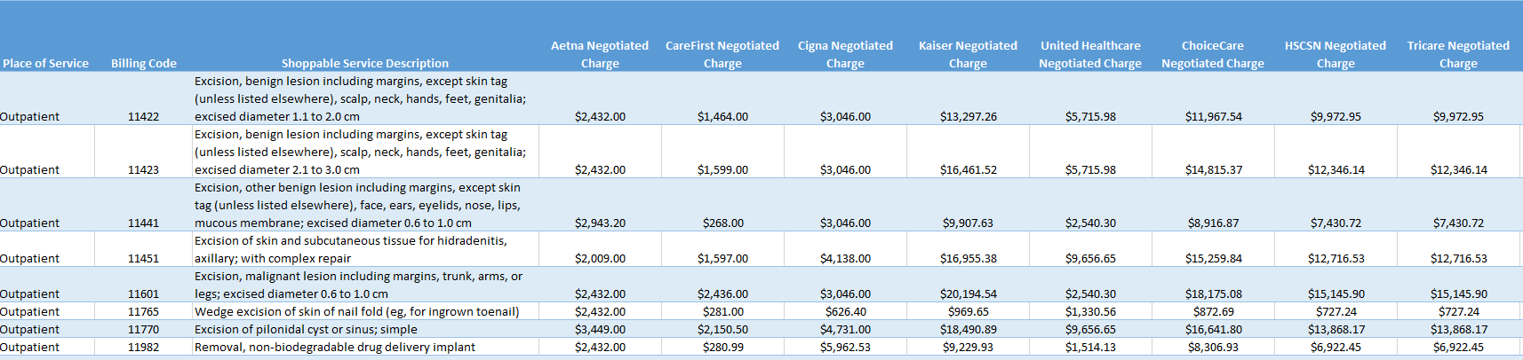
Sample Rate Disclosure from Hospital

